Slide 1
“The North Crossing”
Accessible Connection from Rideau Heights to Kingscourt and the Downtown

Slide 2
The Why Question
Existing Division St overpass not wheelchair accessible
Need to improve K&P Trail connectivity
Need for safe connections from neighbourhoods to new schools, library and community centres

Slide 3
The Who Question
Wheelchair users, family and friends
Rideau Heights and Kingscourt citizens
K&P Trail users – hikers, cyclists, etc.
High school students – city wide

Slide 4
The What Question
Accessible/multi-use trail bridge
Safe, off-road access from north end to downtown and back
Safe route to schools

Slide 5
The When Question
ASAP
City currently working on Active Transportation Master Plan (ATMP)

Slide 6
The Where Question
East of current Division Street vehicle overpass – see map

Slide 7
Expanding on Why
Increase sense of freedom experienced by wheelchair users as off-road trail users
ONE CITY UNITED: Third crossing connects the East. Overpass connects the North
Fits with City’s “Green the City” strategic plan, Sustainability and Climate Action Plan initiatives

Slide 8
Map showing bridge
Red line is current K&P trail routing across Division St overpass
Blue line is new routing with bridge in light blue (90 m)

Slide 9
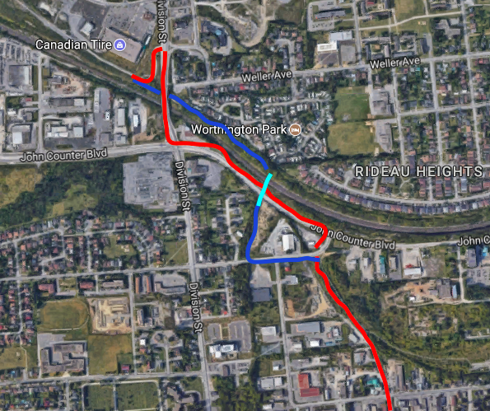

Slide 10
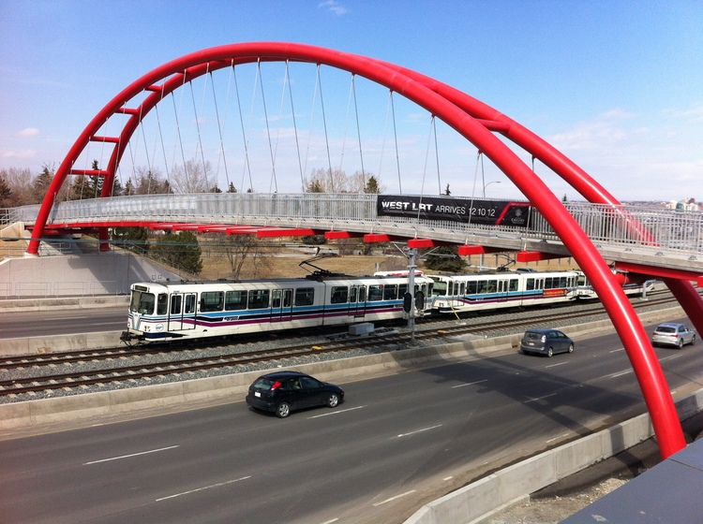
Examples from elsewhere

Slide 11
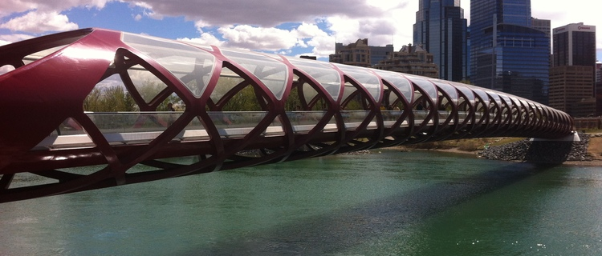
More examples

Slide 12
Possible constraints
Cost (approximately $5 to 6M)
Environmental Assessment required
Time for EA, RFP, design and construction
Staff time and resources

Slide 13
Rewards
Accessible trail increases quality of life for all
Attracts millenials, development and tourism
Neighbourhood connections via K&P Trail
Healthy living for all - especially seniors/youth
Aligns with strategic priorities: Green, Social equity, Livable city, Sustainability

Slide 14
How can MAAC help?
Communicate with ATMP team, Mayor and Council for inclusion in strategic plan and budget
Funding priorities from Ontario Government favour AT and Accessibility
Spread the word with affiliated groups
Attend the Wheelchair Rally in July 2018

